Slide 1

Cattle Breed Classification through Multiple Approaches
A thesis submitted in the fulfilment of the requirements for the degree of
Bachelor of Science in Computer Science & Engineering
by
ANY DAS
ID: 1803510201707
SHAHNAZ SIDDIKA
ID: 1803510201669
IMTIAZ ALAM CHOWDHURY
ID : 1803510201704
Under the guidance of
Md. Neamul Haque
Lecturer
Department of Computer Science &Engineering
Premier University Chittagong

Slide 2
TABLE OF CONTENTS
Problem Domain
Objective
Motivations
Applications
Related Works
Platforms
Background Study
Dataset
Methodology
Result & Observation
Performance Analysis
Performance Comparison
Limitation
Conclusions
Future Recommendations
References

Slide 3
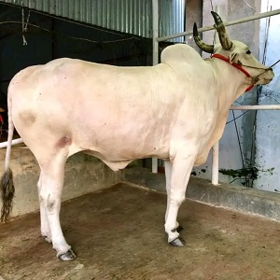
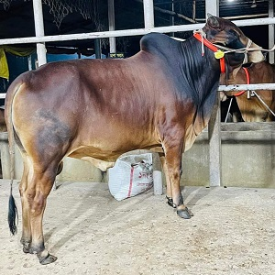
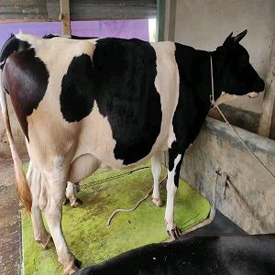
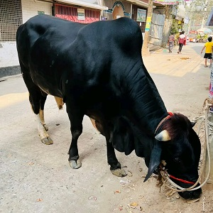
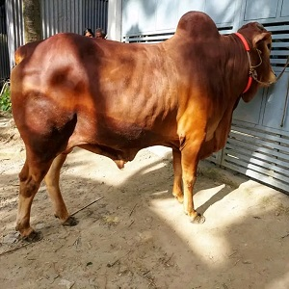
PROBLEM DOMAIN
Detect and identify the cattle breed.
Classify the cattle breed.
(a) White Native (b) Shahiwal (c) Holstein Friesian (d) Black Angus (e) Red Chittagong

Slide 4
OBJECTIVE
To contribute to advancements in agricultural technology by providing efficient and accurate tools for cattle classification, aiding farmers and researchers in optimizing livestock practices.

Slide 5
MOTIVATIONS
Replace ancient cattle detection technique with automation
Provide the farmers an effective system to identify cattle breed by using captured images
Overcome limitations of existing methods
Small dataset
Overfitting
Lower accuracy

Slide 6
APPLICATIONS
Automated systems for farmers.
Facilitate the decision-making process for livestock management.

Slide 7
RELATED WORKS
Table 1. Related works in Cattle breed recognition
No. | Author’s name | Dataset size | Data Augmentation | Analysis Epochs | Model | Accuracy
1 | Jane A. Researcher et al. | Large | Yes | 50 | Convolutional Neural Network (CNN) | 92%
2 | Dr. Mark Scientist et al. | 8,000 | Not Specified | Not Specified | Support Vector Machines(SVM), Random Forests, Deep Neural Networks | 85% (SVM)
3 | Ahmed Investigator et al. | 12,000 | Yes | 50 | Deep Learning Model | 88%

Slide 8
PLATFORMS
Operating System
Windows 10
IDE
Google Colab
Tools Requirement
Python
TensorFlow and Keras
scikit-learn
OpenCV
Matplotlib
PIL
NumPy
Seaborn
mlxtend

Slide 9
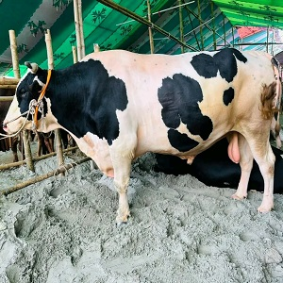
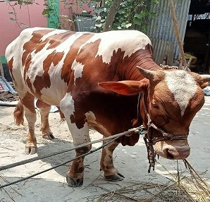
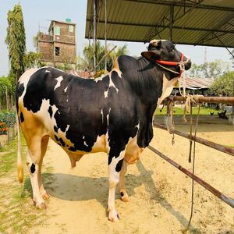
BACKGROUND STUDY
Categories of Cattle Breed:
Holstein Friesian
Characteristics:
Holstein cows have distinctive black and white or red and white markings.
An adult cow can weigh between 690-770 kilograms and measure a height of about 140-165 cm.
The Holstein breed, originating almost 2000 years ago in the Netherlands, emerged from the crossbreeding of black Batavian animals in Germany and white Friesian cattle in Holland.
Figure 1: Holstein Images

Slide 10
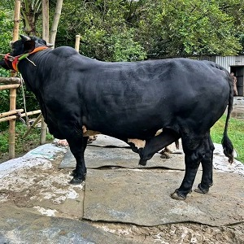
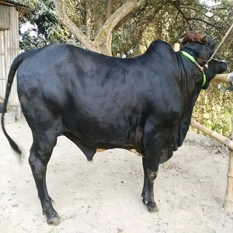
BACKGROUND STUDY (CONT.)
Categories of Cattle Breed:
Black Angus
Characteristics:
Black Angus cattle are naturally polled and can be black or red in colour although black is the dominant color, white may occasionally appear on the udder
Adult Black Angus usually weigh between 450 to 1,000 kg and stand at a shoulder height ranging from 4.5 to 6 feet.
Angus, cattle breed has a deep-rooted history and originated in Scotland, particularly in the counties of Aberdeen and Angus.
Figure 2: Black Angus Images

Slide 11
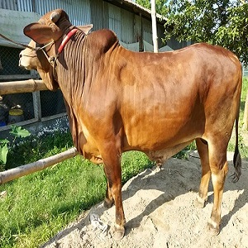
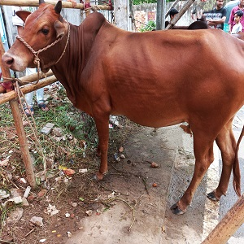
BACKGROUND STUDY (CONT.)
Categories of Cattle Breed:
Red Chittagong
Characteristics:
Red Chittagong cattle are reddish in color. Red Chittagong, also known as RCC.
Mature bulls weigh around 342 kg, while cows weigh approximately 180 kg.
The Red Chittagong breed, has its origins in the Chittagong Hill Tracts region of Bangladesh.
Figure 3: Red Chittagong Images

Slide 12
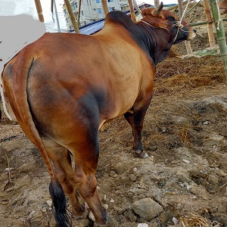
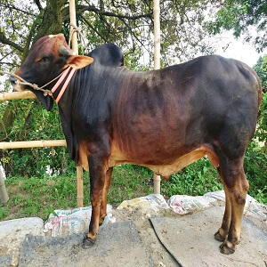
BACKGROUND STUDY (CONT.)
Categories of Cattle Breed:
Shahiwal
Characteristics:
Their colour can range from reddish brown through to the more predominant red, with varying amounts of white on the neck, and the underline.
Average body weight of the mature bulls is between 400 and 500 kg.
Average body weight of the mature cows is between 700 and 800 kg.
The Sahiwal, an ancient cattle breed originating from the region that is now part of Pakistan, has a rich history dating back to the early 20th century.
Figure 4: Shahiwal Images

Slide 13
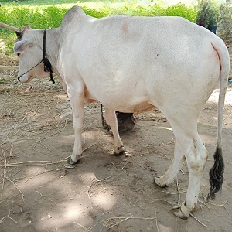
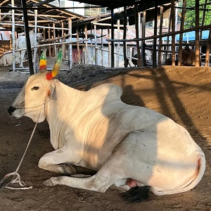
BACKGROUND STUDY (CONT.)
Categories of Cattle Breed:
White Native
Characteristics:
The Cattle colors can vary widely, including shades of brown, black, white, and a mix of these colors.
The White Native Cattle breed is relatively small.
Adult bulls weighing approximately 400 kg and mature cows weighing around 300 kg.
The Native Cattle, colloquially known as "Kalabaw," have a deep-rooted history in the Philippines, reflecting the nation's rich agricultural heritage.
Figure 5: White Native Images

Slide 14
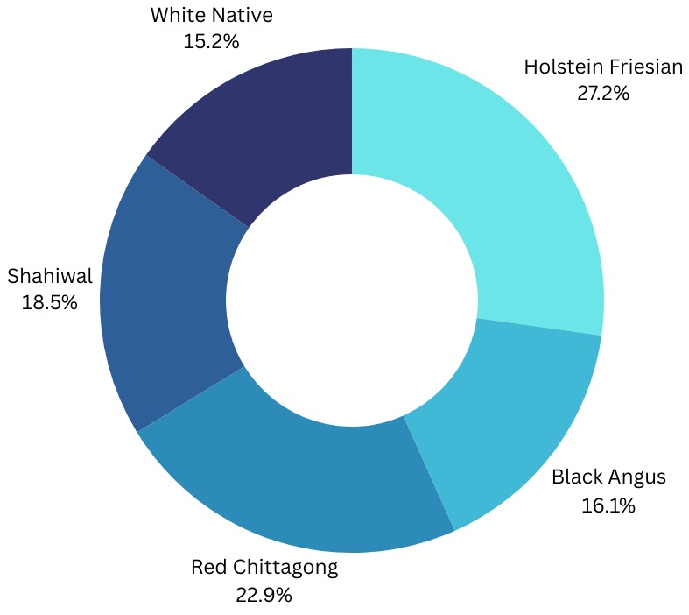
DATASET
Original Dataset
Total 2050 cattle breed images
Holstein Friesian (558 images)
Black Angus (330 images)
Red Chittagong (470 images)
Shahiwal (380 images)
White Native (312 images)
Figure 6: Original Dataset Distribution

Slide 15
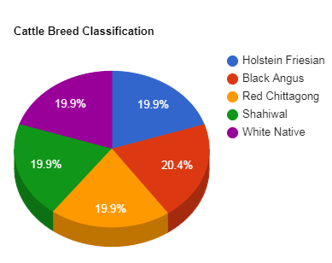
DATASET: Augmented
Dataset after augmentation process
Total 5025 cattle breed images
Holstein Friesian (1000 images)
Black Angus (1025 images)
Red Chittagong (1000 images)
Shahiwal (1000 images)
White Native (1000 images)
Figure 7: Dataset after Augmentation Distribution

Slide 16
DATASET: Statistics & Distributions
Table 2. Dataset description of Cattle breed classification
 | Names | Original images | Distribution Techniques
 |  |  | No. of training images (70%) | No. of test images (30%)
Cattle breeds | Holstein Friesian | 1000 | 710 | 290
 | Black Angus | 1025 | 706 | 319
 | Red Chittagong | 1000 | 714 | 286
 | Shahiwal | 1000 | 682 | 318
 | White Native | 1000 | 706 | 294

Slide 17
METHODOLOGY
Overall Working Process of Cattle Breed Classification
Image Acquisition
Evaluation
Visualization
Image Preprocessing
Model Training
Rescale
Resize
Figure 8: Overall Working Process of Cattle Breed Classification

Slide 18
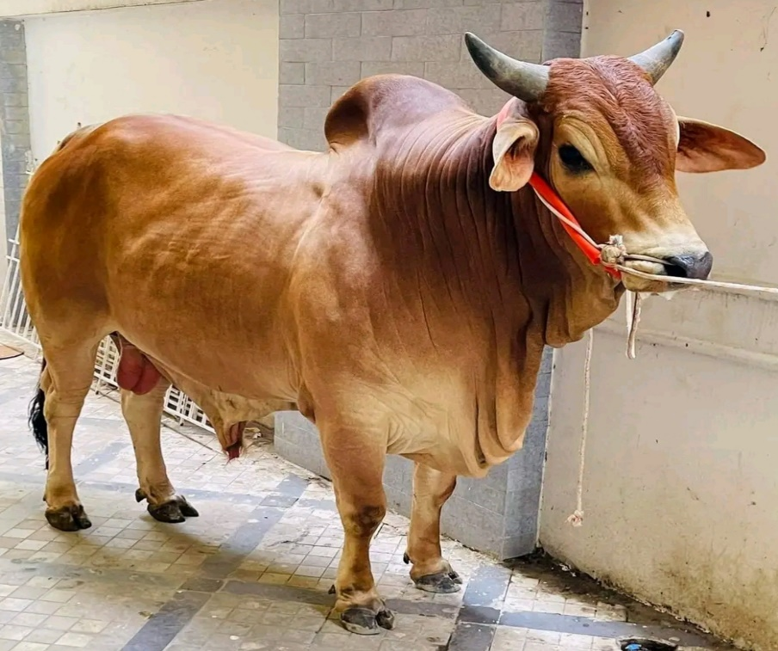

METHODOLOGY (CONT.)
Image Preprocessing
Resizing images into 300*300
Resizing
(a)
(b)
Figure 9: (a) Red Chittagong (X*Y) (b) Red Chittagong (300*300)

Slide 19
METHODOLOGY (CONT.)
Data Augmentation
Rescale
Rotation
Shift
Shear
Flip
Zoom

Slide 20
METHODOLOGY (CONT.)
Work Flow of Data Preprocessing
Data Collection
Image Labeling
Image Resizing
Dataset Splitting
Extraction of Training Data
Extraction of Testing Data
Optimization
Normalization
Figure 10: Work Flow of data preprocessing

Slide 21
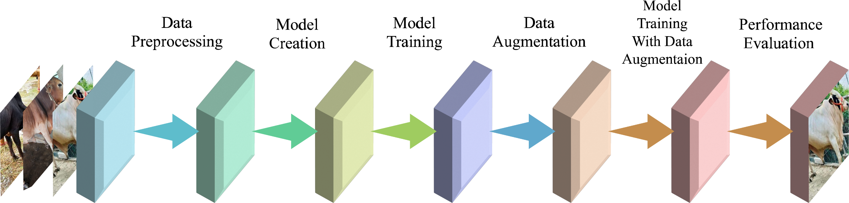
METHODOLOGY (CONT.)
Working Procedure of our CNN model
Figure 11: CNN Work Flow

Slide 22
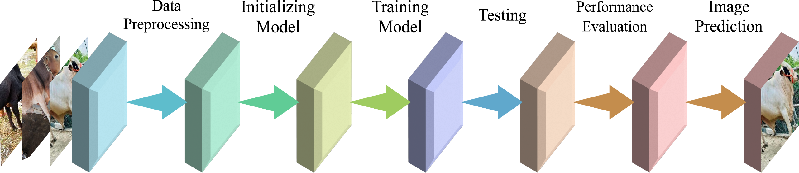
METHODOLOGY (CONT.)
Working Procedure of our SVM model
Figure 12: SVM Work Flow

Slide 23

METHODOLOGY (CONT.)
Working Procedure of our Decision Tree model
Figure 13: Decision Tree Work Flow

Slide 24
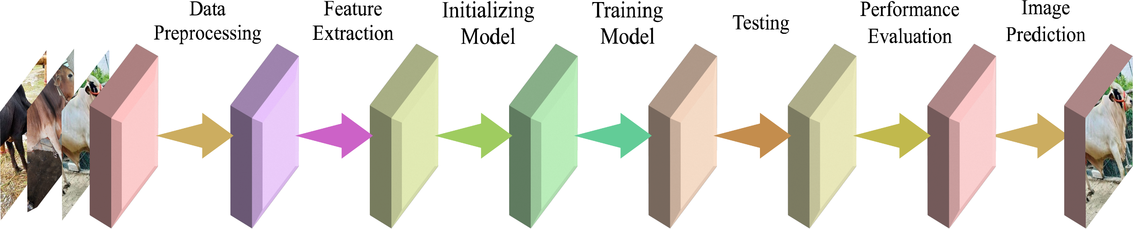
METHODOLOGY (CONT.)
Working Procedure of our KNN model
Figure 14: KNN Work Flow

Slide 25
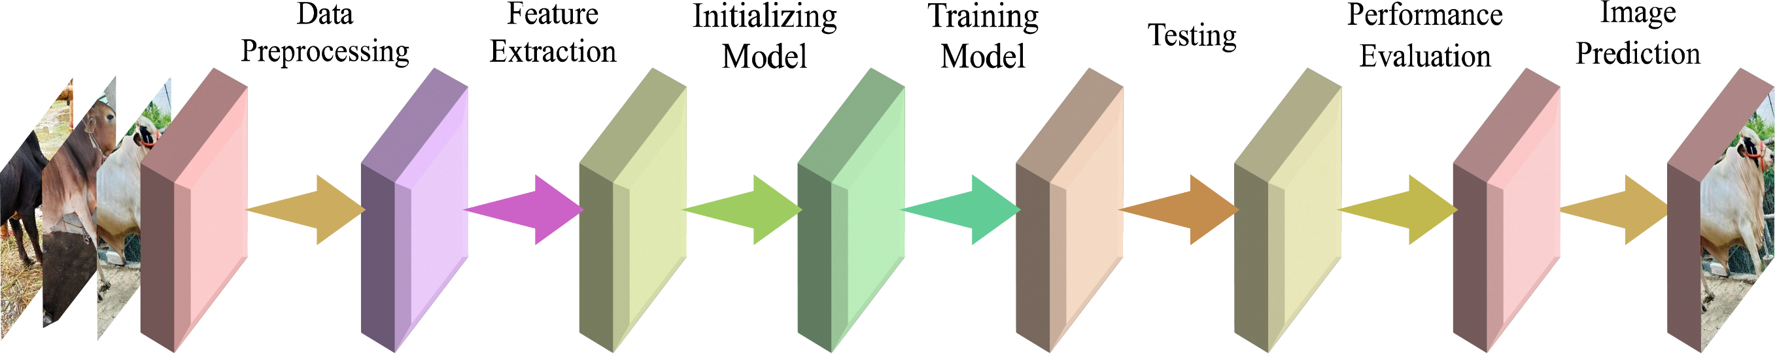
METHODOLOGY (CONT.)
Working Procedure of our Random Forest model
Figure 15: Random Forest Work Flow

Slide 26
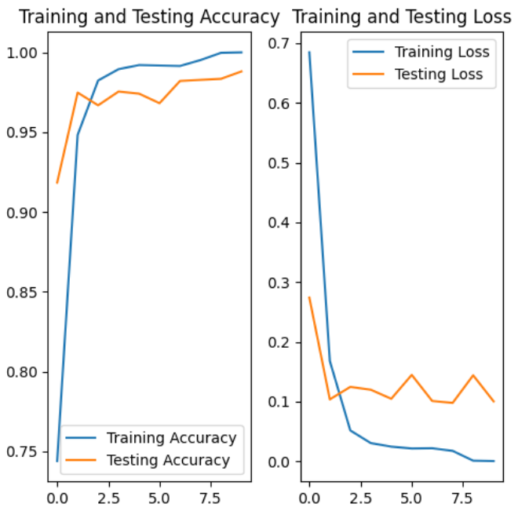
RESULT & OBSERVATION
Training accuracy vs Testing accuracy and Training loss vs Testing loss of CNN Model
Figure 16: Evaluation of Accuracy and loss with The Number of Epochs

Slide 27
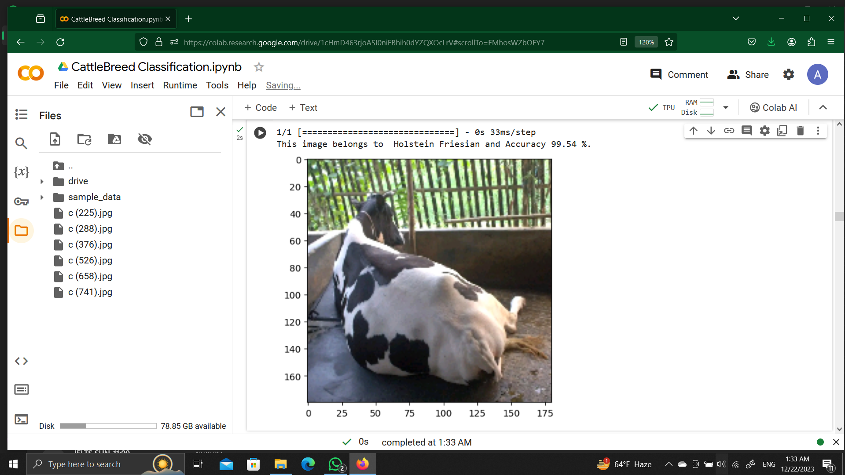
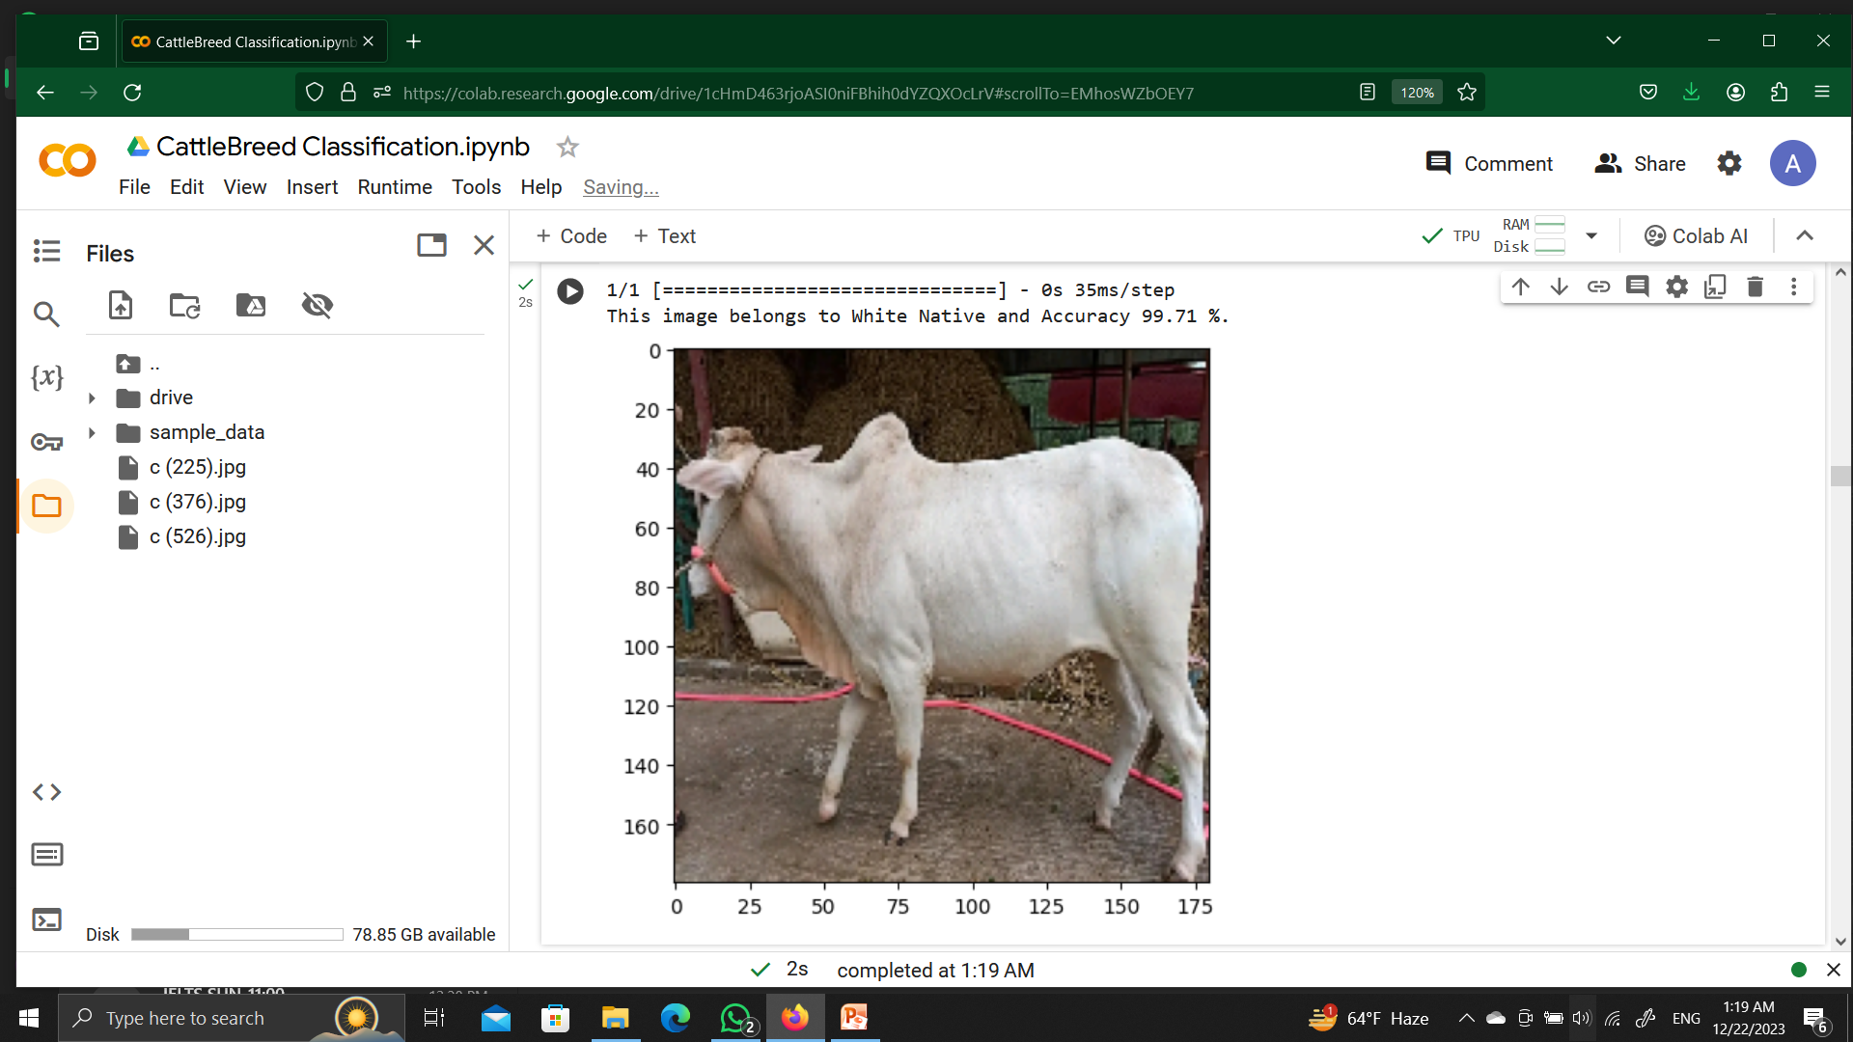
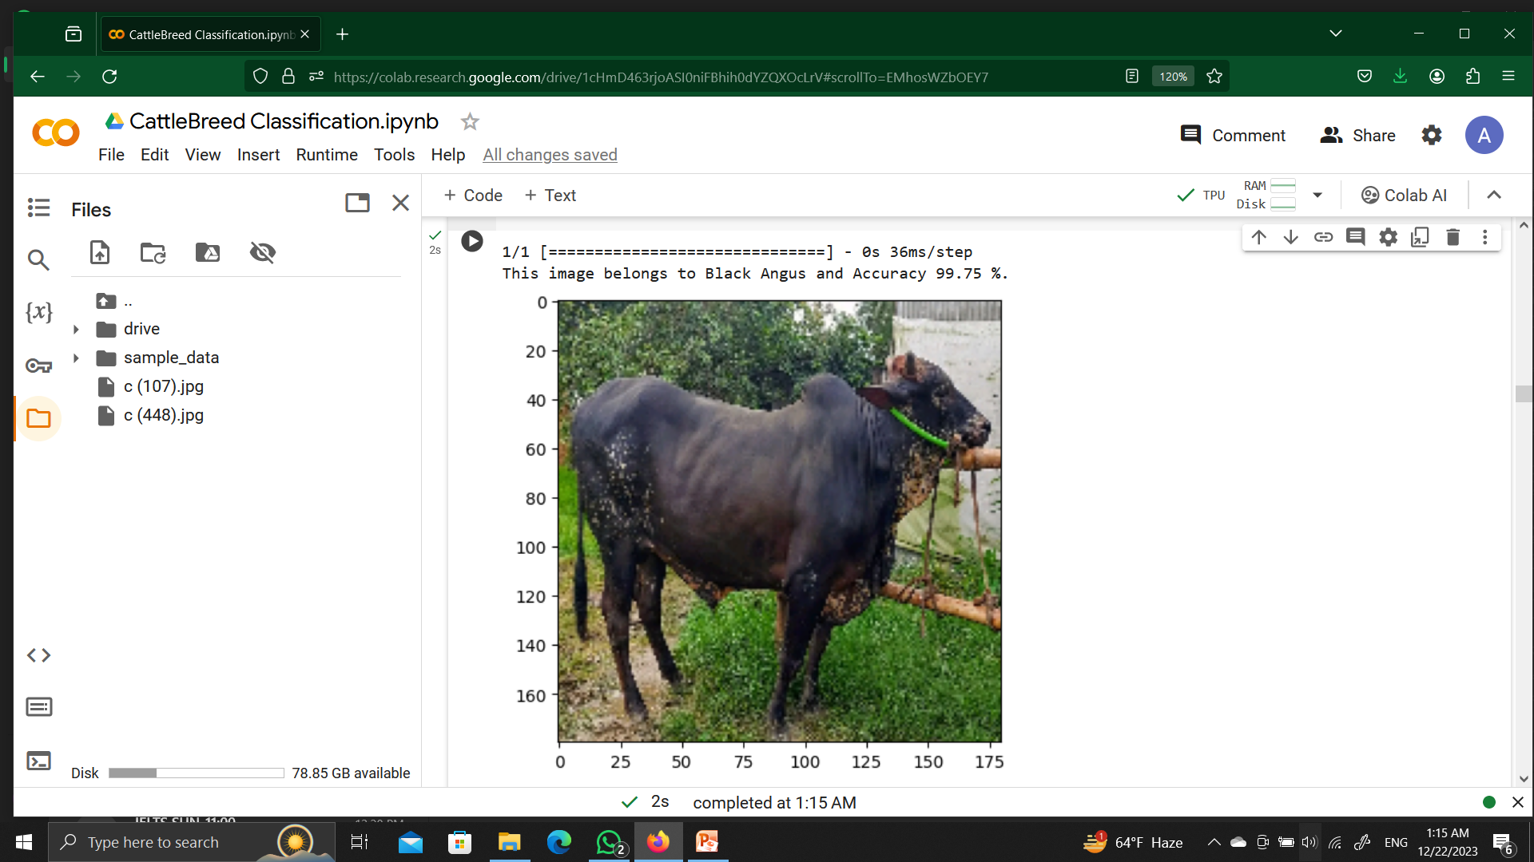
RESULT & OBSERVATION (CONT.)
Single prediction of cattle breed
Figure 17: Correctly classified Cattle breeds

Slide 28
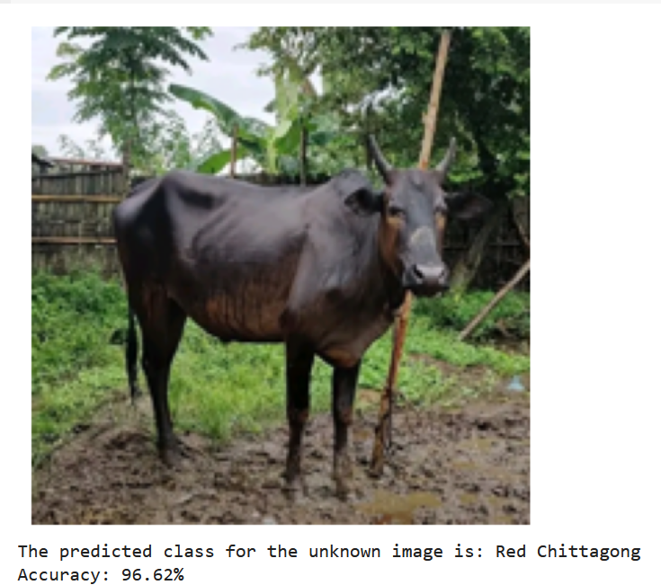
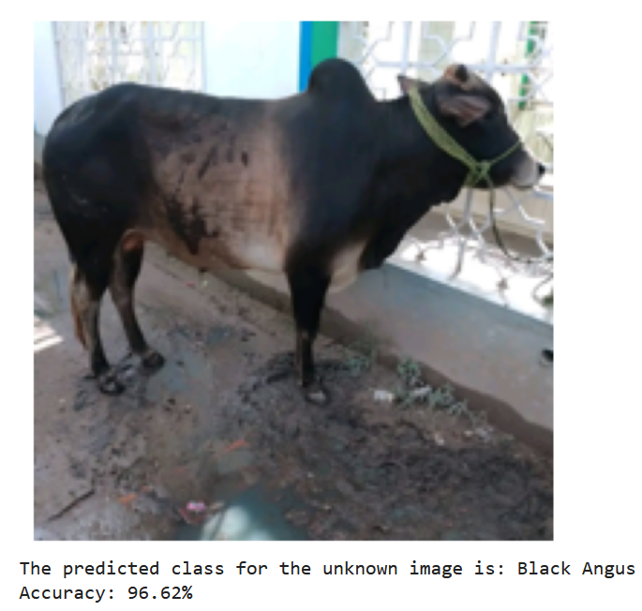
RESULT & OBSERVATION (CONT.)
Single prediction of cattle(cont.)
Figure 18: Misclassified Cattle breeds

Slide 29
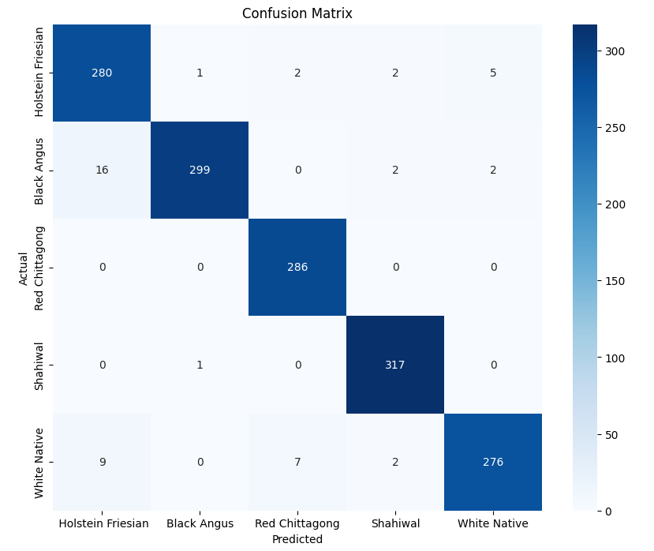
RESULT & OBSERVATION (CONT.)
Confusion matrix of CNN
Figure 19: Confusion Matrix for recognizing cattle breed using CNN

Slide 30
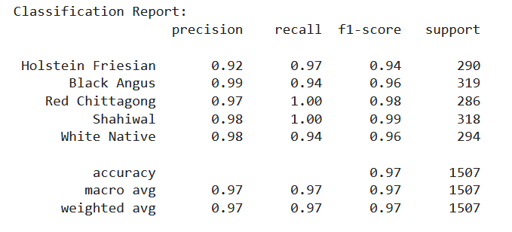
RESULT & OBSERVATION (CONT.)
Classification Report of CNN
Figure 20: Classification Report of CNN

Slide 31
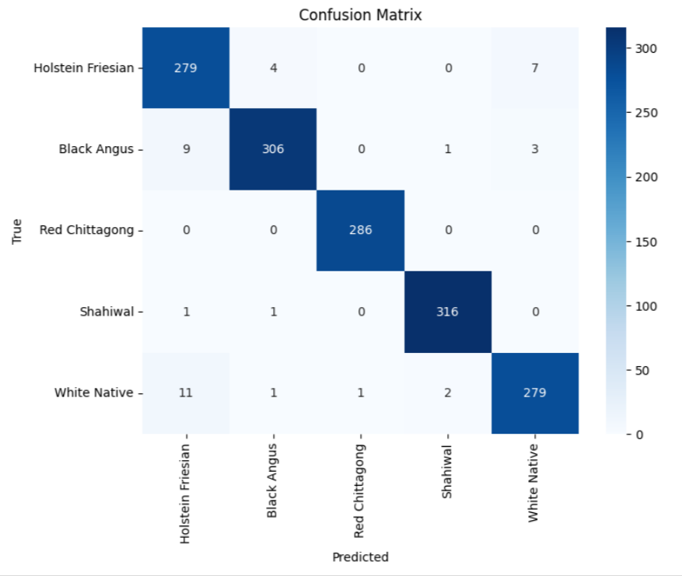
RESULT & OBSERVATION (CONT.)
Confusion matrix of SVM
Figure 21: Confusion Matrix for recognizing cattle breed using SVM

Slide 32
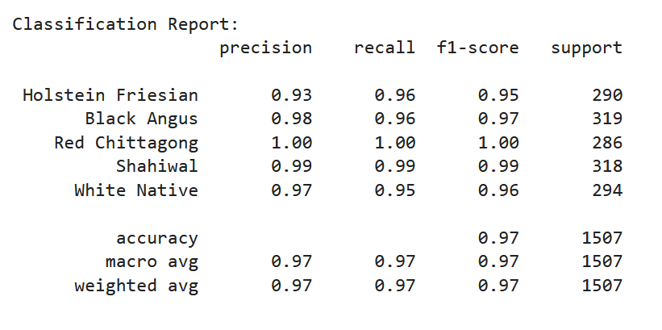
RESULT & OBSERVATION (CONT.)
Classification Report of SVM
Figure 22: Classification Report of SVM

Slide 33

RESULT & OBSERVATION (CONT.)
Confusion matrix of Decision Tree
Figure 23: Confusion Matrix for recognizing cattle breed using Decision Tree

Slide 34
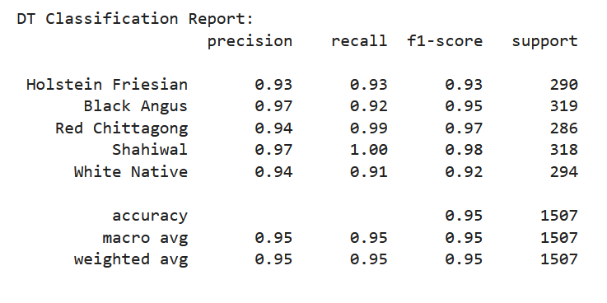
RESULT & OBSERVATION (CONT.)
Classification Report of Decision Tree
Figure 24: Classification Report of Decision Tree

Slide 35
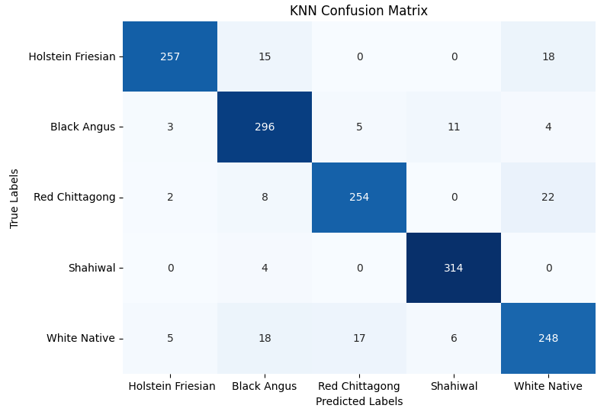
RESULT & OBSERVATION (CONT.)
Confusion matrix of KNN
Figure 25: Confusion Matrix for recognizing cattle breed using KNN

Slide 36
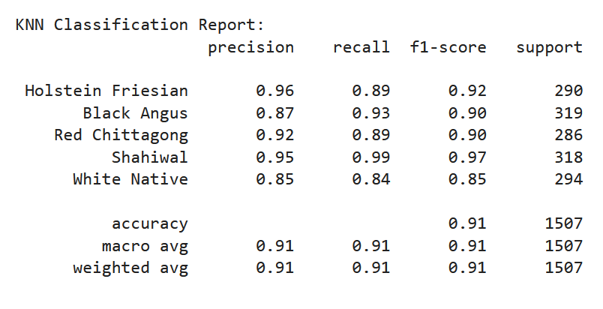
RESULT & OBSERVATION (CONT.)
Classification Report of KNN
Figure 26: Classification Report of KNN

Slide 37
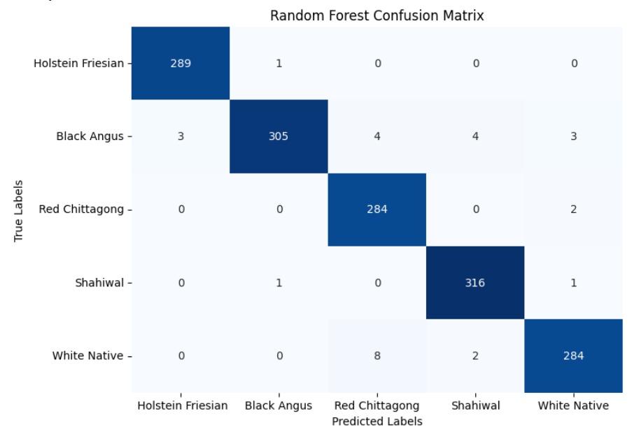
RESULT & OBSERVATION (CONT.)
Confusion matrix of Random Forest
Figure 27: Confusion Matrix for recognizing cattle breed using Random Forest

Slide 38
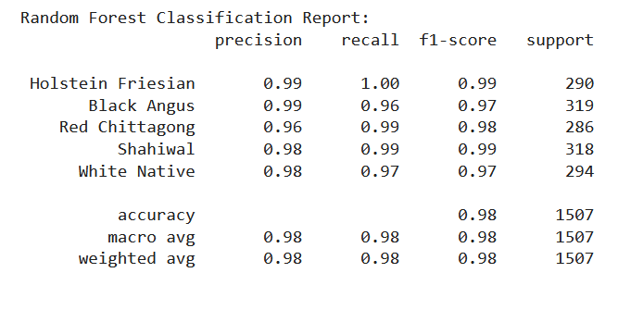
RESULT & OBSERVATION (CONT.)
Classification Report of Random Forest
Figure 28: Classification Report of Random Forest

Slide 39
RESULT & OBSERVATION (CONT.)
Table 3: Overall Result of Cattle Breed Classification
Model | precision | recall | f1-score | Accuracy
Support Vector Machine | 0.9731 | 0.9728 | 0.9728 | 97%
Decision Tree | 0.9517 | 0.9516 | 0.9513 | 95%
K-nearest Neighbor | 0.9095 | 0.9084 | 0.9083 | 91%
Random Forest | 0.9810 | 0.9808 | 0.9807 | 98%
CNN | 0.9675 | 0.9677 | 0.9672 | 97%
Figure 27: Classification report

Slide 40
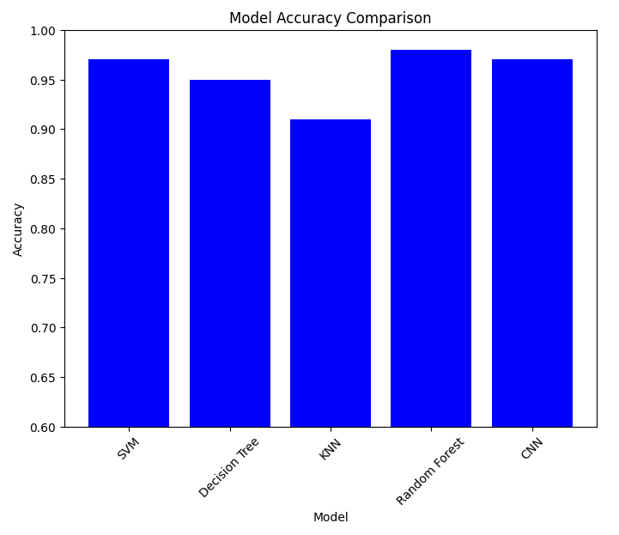
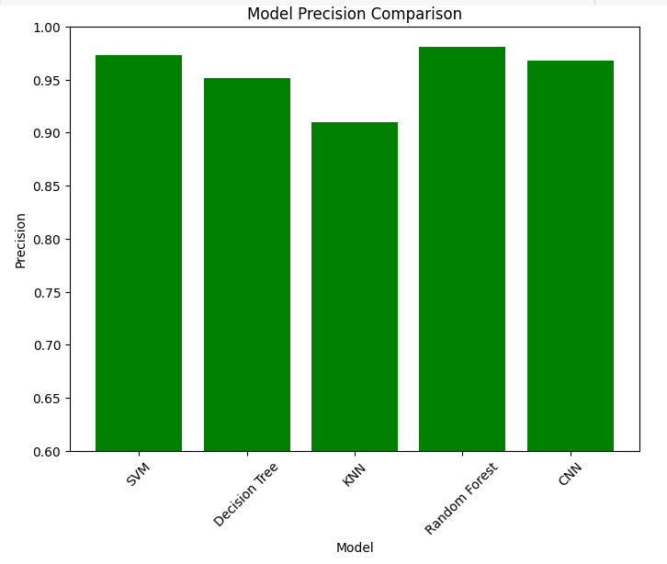
RESULT & OBSERVATION (CONT.)
Comparison of each model
Figure 29: Model Accuracy Comparison Figure 30: Model Precision Comparison

Slide 41
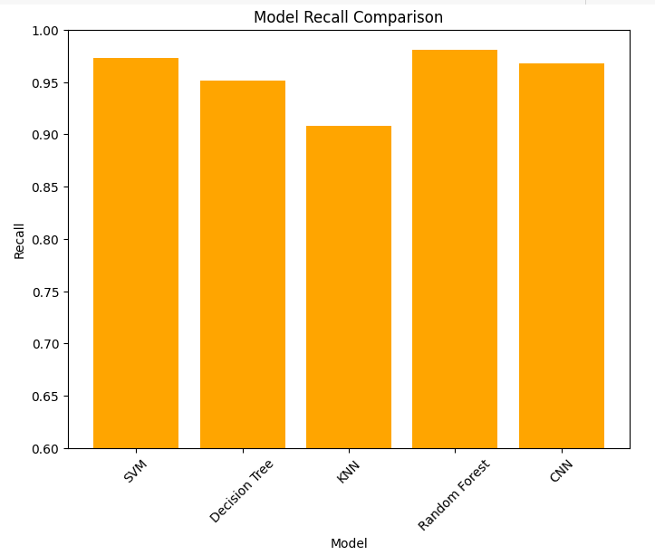
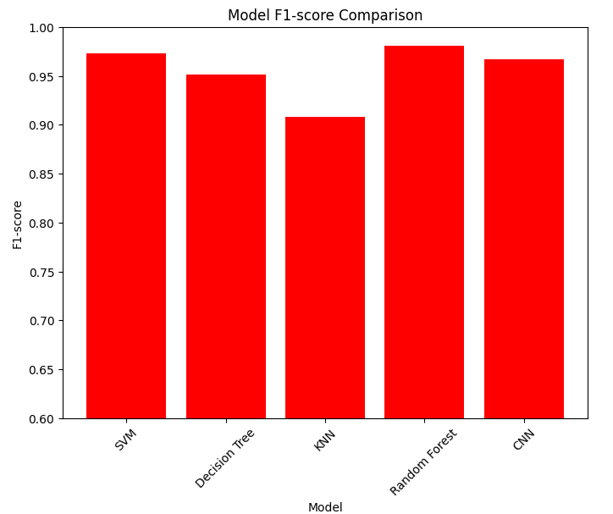
RESULT & OBSERVATION (CONT.)
Comparison of each model
Figure 31: Model Recall Comparison Figure 32: Model F1-score Comparison

Slide 42
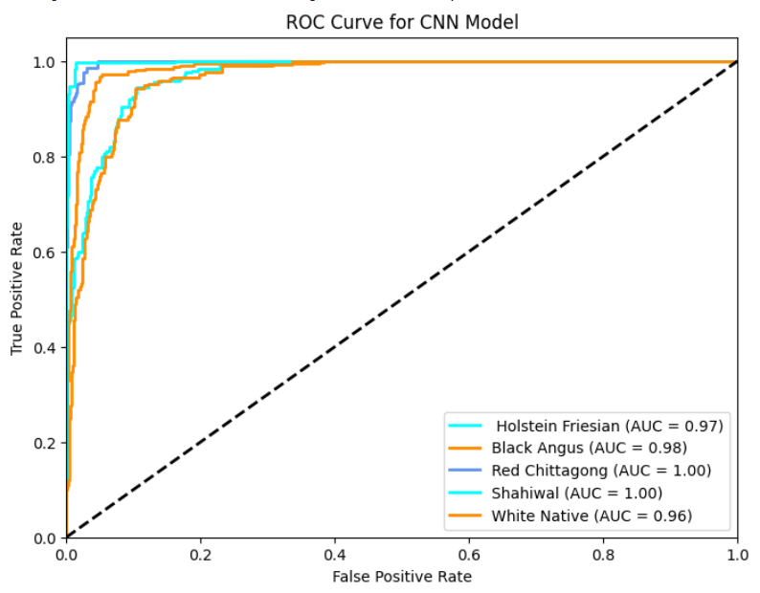
RESULT & OBSERVATION (CONT.)
Measuring performance according to ROC curve for CNN model
Figure 33: ROC curve of cattle breed recognition

Slide 43
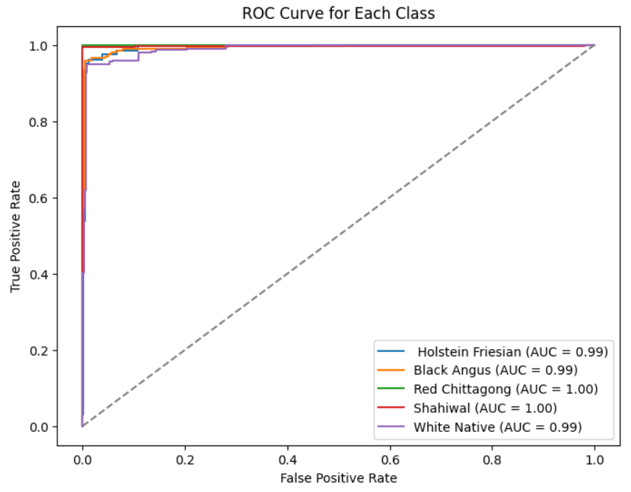
RESULT & OBSERVATION (CONT.)
Measuring performance according to ROC curve for SVM model
Figure 34: ROC curve of cattle breed recognition

Slide 44
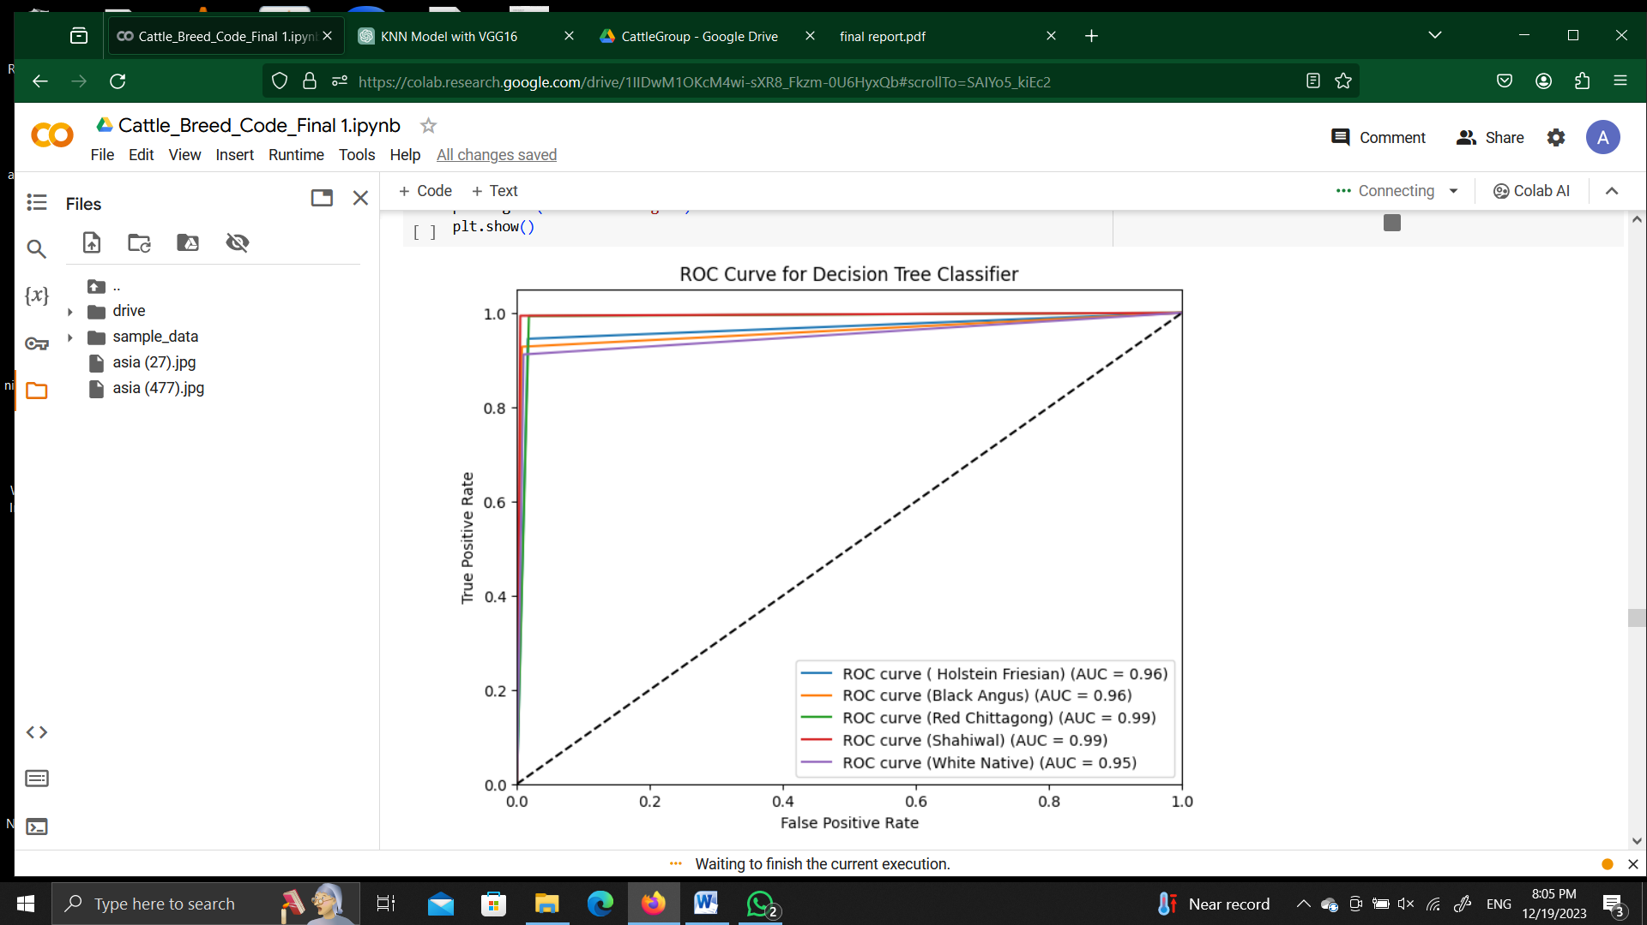
RESULT & OBSERVATION (CONT.)
Measuring performance according to ROC curve for Decision Tree
Figure 35: ROC curve of cattle breed recognition

Slide 45
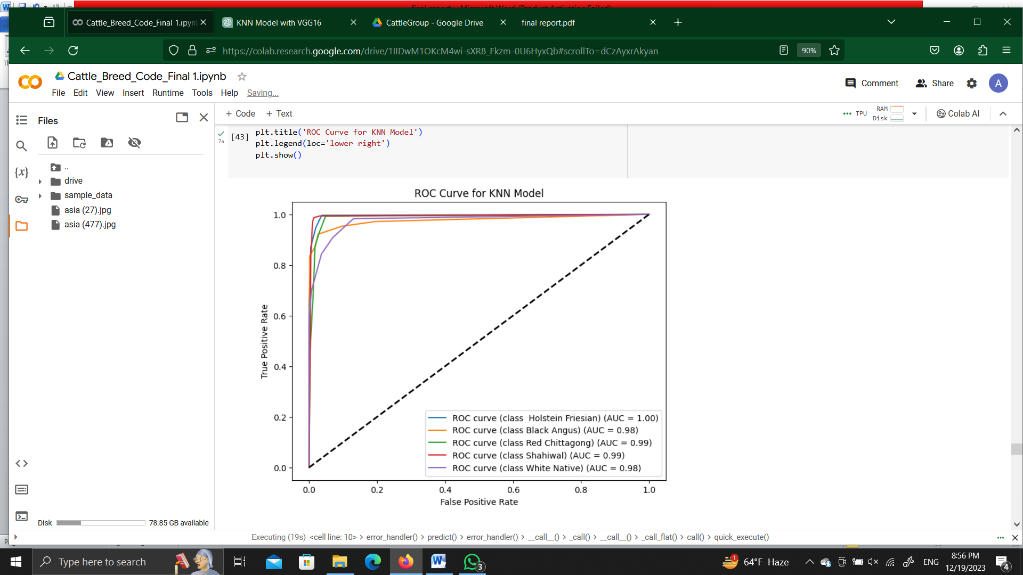
RESULT & OBSERVATION (CONT.)
Measuring performance according to ROC curve for KNN model
Figure 36: ROC curve of cattle breed recognition

Slide 46
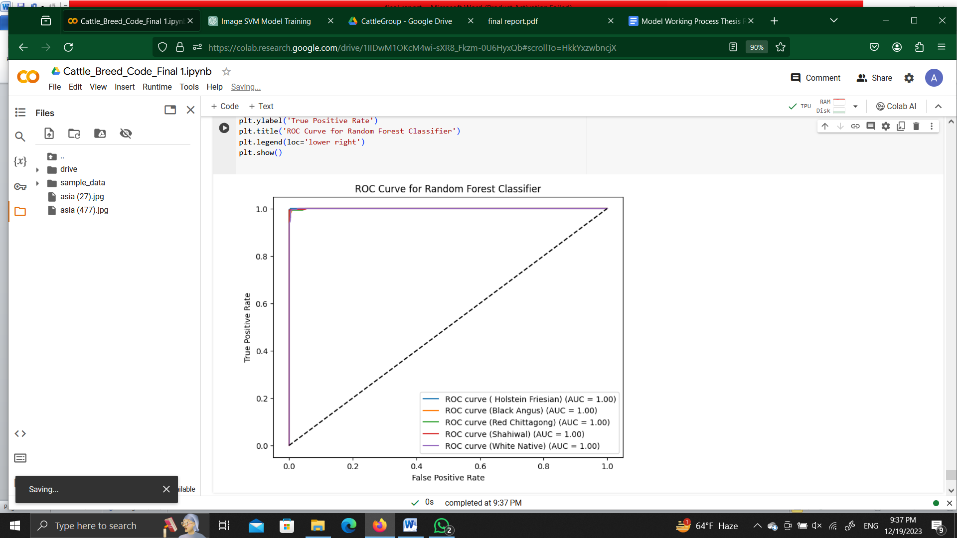
RESULT & OBSERVATION (CONT.)
Measuring performance according to ROC curve for Random Forest model
Figure 37: ROC curve of cattle breed recognition

Slide 47
Performance Analysis
Table 4. Comparative Insights of ROC-AUC Curve
Cattle Breed | CNN | SVM | KNN | Decision Tree | Random Forest
Holstein Friesian | 0.97 | 0.99 | 1.00 | 0.96 | 1.00
Black Angus | 0.98 | 0.99 | 0.98 | 0.96 | 1.00
Red Chittagong | 1.00 | 1.00 | 0.99 | 0.99 | 1.00
Sahiwal | 1.00 | 1.00 | 0.99 | 0.99 | 1.00
White Native | 0.96 | 0.99 | 0.98 | 0.95 | 1.00

Slide 48
Performance Comparison
Comparison with related works on Cattle breeds classification
Extensive Dataset Variety
High Accuracy Across Models
Effective Use of Data Augmentation
Random Forest Model Excellence

Slide 49
LIMITATION
The dataset may not fully encompass global cattle breeds, impacting the model's versatility.
Our models are limited to recognizing only five distinct cattle types.

Slide 50
CONCLUSIONS
Propose a image scratching model
Proper detection of cattle breeds type
Accurately classifying the specific cattle breeds showcased in the dataset
Empowering farmers
Achieves high accuracy

Slide 51
FUTURE RECOMMENDATIONS
Continuously update the dataset to encompass a more comprehensive range of cattle variations and environmental conditions.
Explore the integration of advanced deep learning architectures to enhance classification accuracy.
Explore the potential for transfer learning to leverage pre-trained models for improved performance.

Slide 52
REFERENCES
[1] R. Kasarda, N. Moravčíková, Gábor Mészáros, Mojca Simčić, and D. Zaborski, “Classification of cattle breeds based on the random forest approach,” Livestock Science, vol. 267, pp. 105143– 105143, Jan. 2023, doi: https://doi.org/10.1016/j.livsci.2022.105143
[2] S. Li et al, “Individual dairy cow identification based on lightweight convolutional neural network,” PLOS ONE, vol. 16, no. 11, p. e0260510, Nov. 2021, doi: https://doi.org/10.1371/journal.pone.0260510
[3] M.E. Hossain et al., .“A systematic review of machine learning techniques for cattle identification: Datasets, methods and Future Directions,” Artificial Intelligence in Agriculture, vol. 6,pp. 138– 155, 2022. doi:10.1016/j.aiia.2022.09.002

Slide 53
Thank You

